Slide 1


Shell Enhancements
Steven Bucher
PowerShell Team
Notes:
Hello everyone and welcome to the shell enhance session, we are going to be talking about some of the ways you can enhance your shell experience. My name is Steven Bucher and I am a product manager on the PowerShell team responsible for helping create new enhancements to the interactive experience to PowerShell.

Slide 2

Artificial Intelligence Is Top Of Mind
Believe that A.I is going to be a vital tool for development operations
People are going to are going to start to integrate A.I into their daily work
Whether it be in the shell or not
A.I will be accelerating the need to effective assistance
Committed to increasing assistance that can be A.I empowered but experience focused
Non-disruptive, helpful experience
Notes:
So want to start off talking at a high level about enhancements, expectations and assistance to give everyone a better idea of how we are approaching enhancing the shell experience.
So first and fore most artificial intelligence is top of mind for everyone right now. ChatGPT, OpenAI have proven that Artifical intelligence can be an extremely Powerful tool. My stance on A.I and the teams stance is that we believe that A.I is going to be a vital tool for development operations. I personally have been using some of the tools available now to help me at my work or with various prototyping and coding projects I am doing.
If you use A.I in your daily work I would love to talk to you. I will be here all week and would love to hear all about what you may be currently doing and your thoughts on A.I in general.
I believe that people are going to start integrating A.I intotheir daily work whether or not it will be in the shell. For someone relatively new and inexperienced with PowerShell I find it to be pretty effective as it is today and its likely going to get so much better in the future.
However I think there will be another consequence of A.I becoming more “Main stream” is that it will accelerate the need for effective assistance. Now we already see ”A.I” enhancements in everyday work with simple things like search bars in web browsers or now with email clients that can help predict the next common word. I think A.I will make people using tech use to an enhanced experience and thus PowerShell needs to improve its interactive experience to meet users growing expectations for assistance. Now this is not particularly new, everyone wants very clear error messages after errors occur right? That is a form of assistance in the CLI.
As a result we are commited to increasing assistance that can be A.I empowered but focus ourselves on the experience of it in PowerShell to make it feel natural and give users customizability for their shell experience.
Utlimately we hope to design non disruptive and helpful experience to the shell. Whether it be a.i powered tools or not.

Slide 3
PowerShell Predictive IntelliSense
Implemented in order to accelerate and enhance your interactive console experience
Two type of predictors
History
Plugin
History for acceleration
Plugins for enhancement
Notes:
So the first kind of enhancement I want to talk about is PSReadline’s predictive intellisense, this is something I have shown before and showed a little earlier today in the state of the shell.
But on a base level what is Predictive IntelliSense in PowerShell?
Well simply put it is an enhancement in the shell that helps predict what you are going to be typing or executing next.
It was built in order to accelerate and enhance your interactive console experience.
They are available in PSReadLine 2.2.6 which is a module shipped with PowerShell that provide Command Line enhancements such as color handling, key bindings, editing capabilities and so much more.

Slide 4
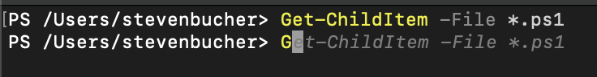
History Predictor
Fills in history that matches characters being typed
Compatibility
Supported everywhere PowerShell is supported!
Turned on by default
Persistent across sessions
Notes:
History predictor is now on by default and uses your past history to give suggestions based on what you are currently typing.
<see example here>
These can help accelerate your work especially when running the same commands over and over. Or even if you have ran one once in the past but don’t remember the parameter or param set. If you get close enough you can see it.
You’ll notice in todays demo I will be doing a lot of that

Slide 5
Plugin Predictors
Extensibility for Predictors!
PowerShell modules that provide predictions
Compatibility
Only available on PowerShell 7.2+
PSReadLine v2.2.6
Default in 2.2.6
Notes:
Plugin predictors is when it can get really interesting and when predictors can provide new suggestions that you may never have ran.
They are extensible and so plugin predictors are just imported PowerShell modules that utilize the ICommandPredictor subsystem.
You can put these modules in your profile in order to have them always on by default
These however are only compatible with PowerShell 7.2+ and the latest stable version of PSReadLine.
Will be defaulted to be on but no predictor module will be imported so it just seems that history is the only one.

Slide 6

Notes:
Let me show you how predictors can help improve your life when doing using PowerShell
<refer to Demo.ps1>

Slide 7
Some AWESOME Plugin Predictors
Completion Predictor
Az.Tools.Predictor
Community Predictors
PnP.PowerShell.Predictor
PowerType
Directory Predictor
And many more!
Notes:
Completion predictor uses tab completion to help give suggestions for parameters and properties for objects.

Slide 8
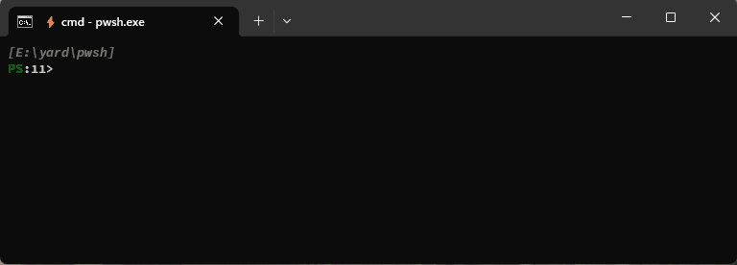
Predictor Improvements – PSReadLine 2.3.0-beta0
Scrollable View
Adjustable height
Deduplication
Available in PSReadLine2.3.0-beta.0
BUNCH of stability improvements
Demo time again!
Notes:
Demo most of this
Release log of 2.3.0 has a lot of bug fixes, improving stability a lot!

Slide 9
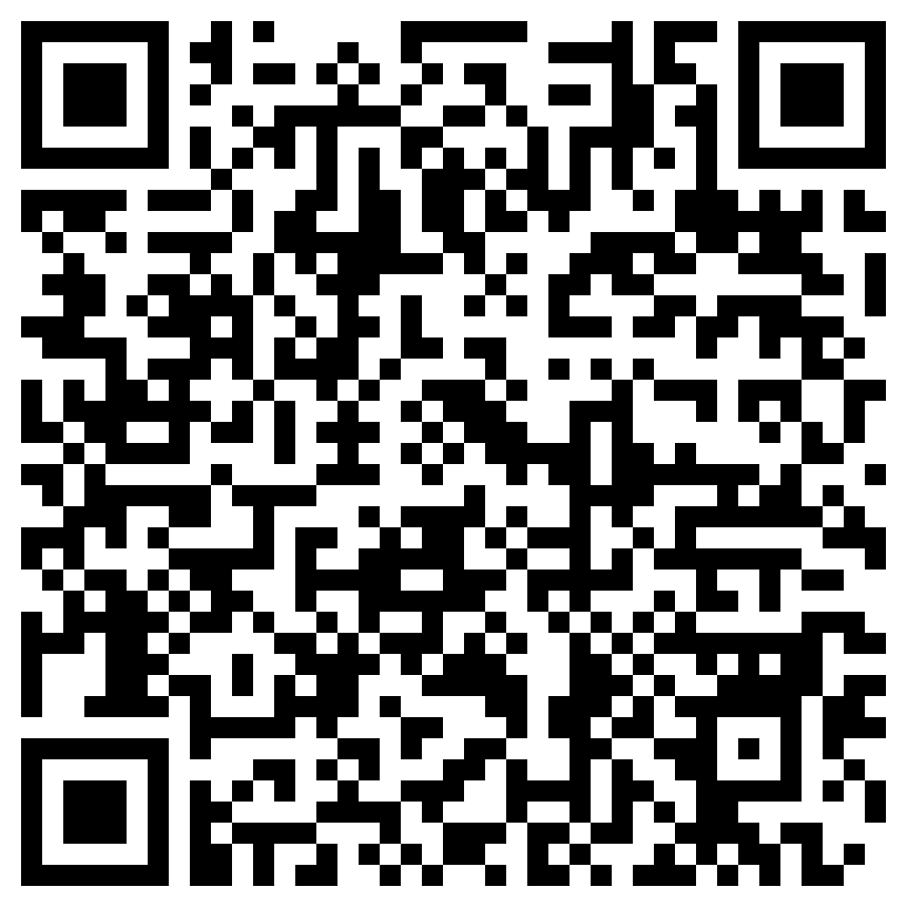
Creating your own Predictor
Step by step instructions in our Docs
http://aka.ms/PSPredictorDoc
Notes:
Don’t want to demo how to do it,

Slide 10
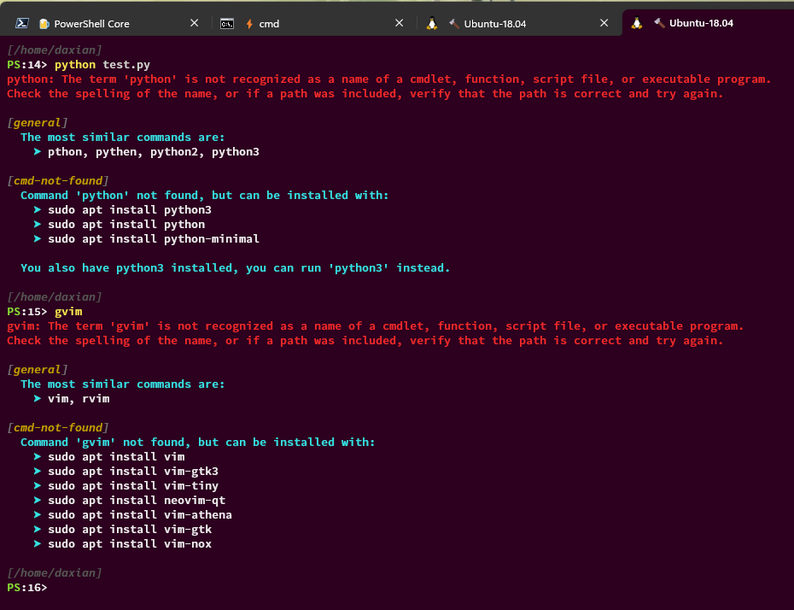
Feedback Providers
Predictors are preventative but we know errors will always be inevitable
Next evolution of assistance in the shell
Feedback Providers are PowerShell modules that subscribe to the IFeedbackProvider interface
Trigger on defined errors and give suggestions
Currently have one built in one to suggest installed commands [General]
Lots of development coming soon in the future
Notes:
Now onto another amazing way to enhance your shell experience. This is something brand new we are working on and is currently still in development but wanted to share as it aligned with our goals to help enhance PowerShell and make it the best most assistive shell.
Took the learnings from PSReadLine predictors and are beginning to apply them in Feedback Providers.

Slide 11
Feedback Providers
Notes:
Record a demo?
HIGHLIGHT THE PREDICTOR STUFF
Command not found suggestion has been available in Bash forever!! With the feedback provider we can enlighten this experience in PowerShell and then show off what is better about our solution
PREDICTORS! BOOM its already there!!

Slide 12
Enhancements in the shell doesn't end there!
PSReadLine Key Handlers
PSReadLine Options
$PSStyle
$PSDefaultParameterValues
Sample Profile
Notes:
The PSReadLine module provides key handlers that map PSReadLine functions to keyboard chords
Other PSReadLine Options
The $PSDefaultParameterValues preference variable lets you specify custom default values for any cmdlet or advanced function

Slide 13
Questions?

Slide 14


We love hearing from you!
@StevenBucher13
@PowerShell_Team
@StevenBucher98
@daxian-dbw
Github.com/PowerShell/PSReadLine/

